Slide 1








GHG ATLAS!
Research GHGs around us!
EcoSustain Lab.

Slide 2




OUR CHALLENGE
1.
Visualize how much GHG emissions from anthropogenic and natural sources contribute to global warming!
Points
・Human-caused GHG Emissions
・Natural GHG Sources and Sinks
・Large GHG Emission Events
・Use a combination of satellite and model-based datasets
・How innovative is the use of data

Slide 3
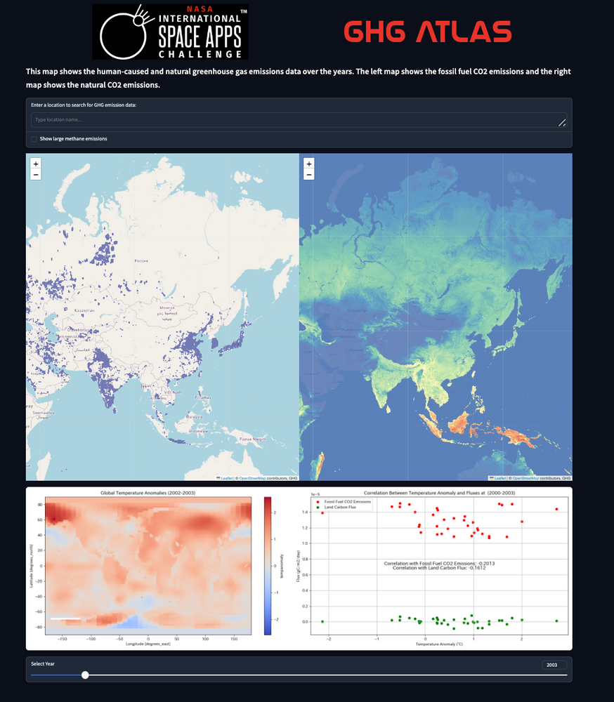
ABOUT GHG ATLAS
2.
An app to visualize and compare GHG emissions!
・Location Search Bar
・CH4 mass visualization
CO2 emissions from natural causes
CO2 emissions from anthropogenic sources
Relationship between temperature change and each CO2 emission
Temperature change over 1 year
Year Selection Bar

Slide 4
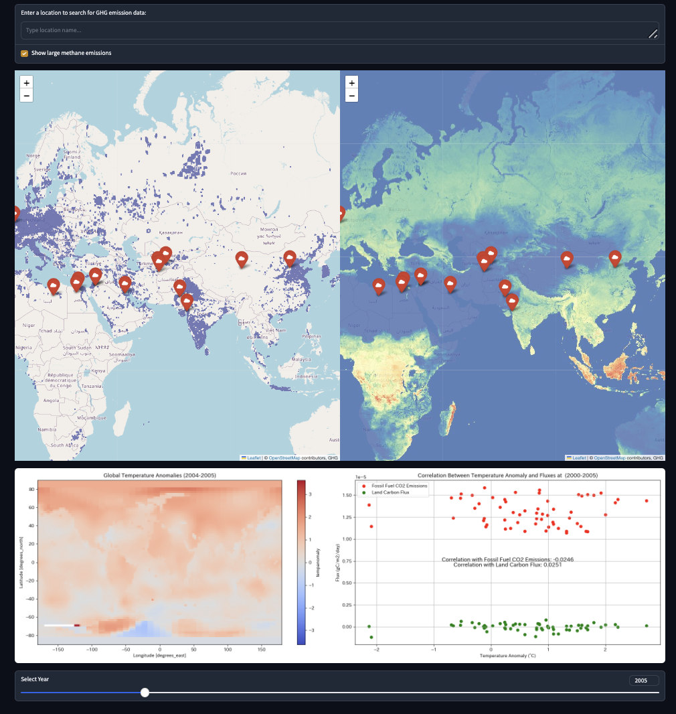
USABILITY
3.
Simple and user-friendly!
You can choose to visualize CH4!
Search in any language!
Dynamic, can scroll simultaneously!
Maps are updated in real time!

Slide 5
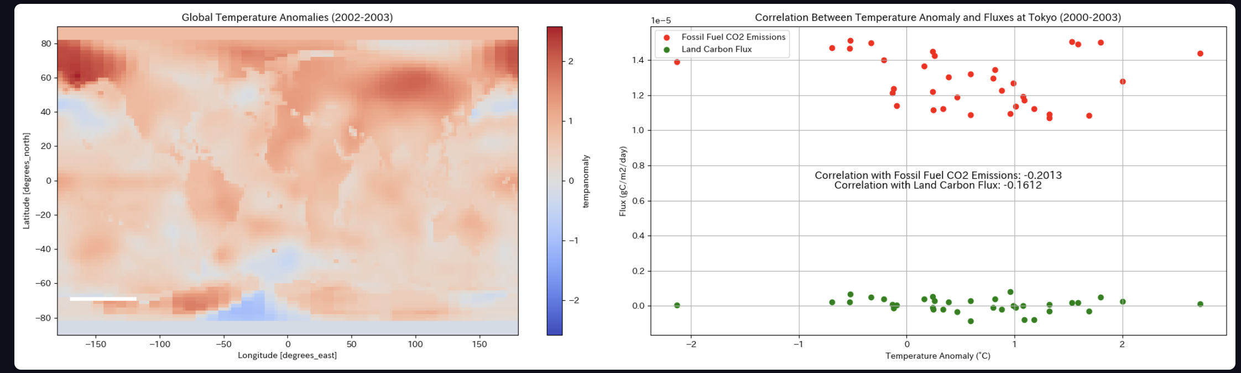
COMPARABILITY
4.
Comparing Innovations
Comparisons can be made on a global scale by factor!
The relationship between anthropogenic and natural factors and global warming is easily understood!
Temperature changes and GHG emissions can be compared at a glance!

Slide 6
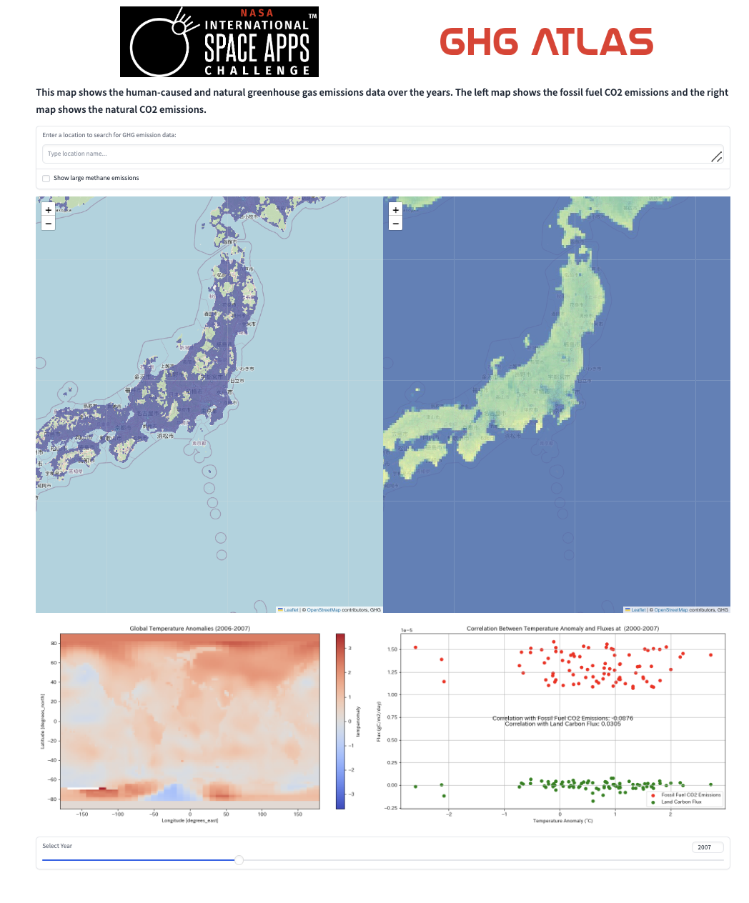
ACCESSIBILITY
5.
Available to everyone via the Internet!
Easy to use for everyone!
Light Theme
Dark Theme
Response within 3 seconds

Slide 7
ACHIEVEMENT
6.
☑️ Use human-caused GHG emissions data
☑️ Use natural GHG sources and sinks data
☑️ Use large GHG emissions events data
☑️ Use a combination of satellite and model-based datasets
☑️ Good use of data provided by NASA
☑️ Innovative Data Usage
Usability & Comparability & Accessibility

